Slide 1

Zomato Restaurants Data Analysis

Slide 2
Project Journey
Phase 1
Phase 2
Phase 3
Phase 4
Understanding the problem statement and data description of the given dataset
Cleaned the raw data by removing the unwanted columns and adding few new ones
Start analyzing the data in Excel and putting forward the insights we gathered during the process
Create a dashboard in Excel and provided recommendations on the basis of insights acquired

Slide 3

PHASE 1
We will see our problem statement and data description and will formulate the further strategy to approach the problem. Data description includes the description of each column in dataset and it’s significance.

Slide 4
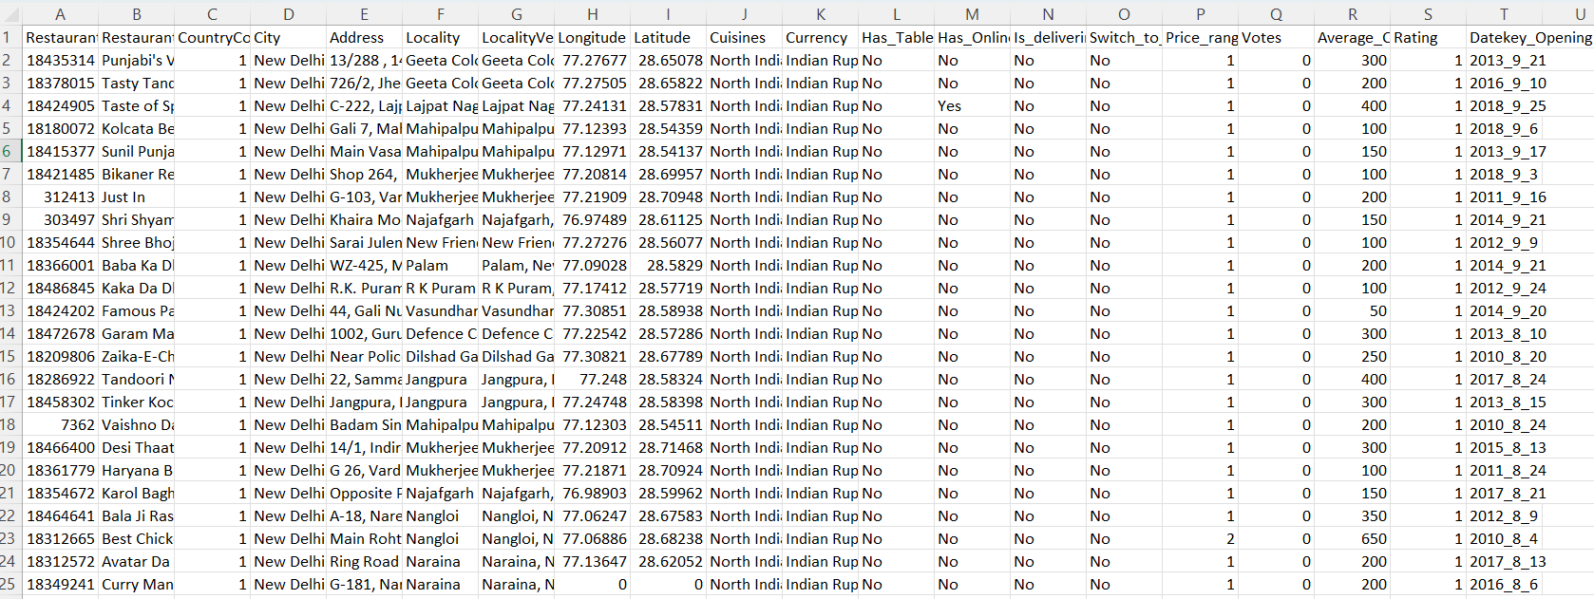
Problem Statement
You are hired as a consultant data analyst by zomato where the team is looking for expansion and opening restaurants. Your task is to come up with strategies/suggestions about opening newer restaurants.

Slide 5
Data Description
Restaurant ID: Unique identifier for each restaurant.
Restaurant Name: The name of the restaurant.
Country Code: Country code of the location where the restaurant is situated.
City: The city where the restaurant is located.
Address: The specific address of the restaurant.
Locality: The locality or neighborhood where the restaurant is situated.
Locality Verbose: Detailed information about the locality.
Longitude: The geographical longitude coordinate of the restaurant.
Latitude: The geographical latitude coordinate of the restaurant.
Cuisines: The type of cuisine offered by the restaurant.
Currency: The currency used for transactions in the restaurant.
Has_Table_booking: Indicates whether the restaurant has a table booking option (Yes/No).
Has_Online_delivery: Indicates whether the restaurant offers online delivery (Yes/No).
Is_delivering_now: Indicates whether the restaurant is currently delivering (Yes/No).
Switch_to_order_menu: Indicates whether users can switch to the order menu (Yes/No).
Price_range: A numeric value indicating the price range category of the restaurant.
Votes: The number of votes or ratings/(feedback) received by the restaurant.
Average_Cost_for_two: The average cost for two people dining at the restaurant.
Rating: The overall rating of the restaurant is based on user reviews.
Datekey_opening: The date when the restaurant was opened.

Slide 6
PHASE 2
Now when we are done with understanding our problem statement and dataset, we will start cleaning our data. In this process we’ll remove any null values, remove any columns that are not necessary in achieving our goal and will also add some more calculated columns.

Slide 7
Data Cleaning
Data cleaning is a crucial step in the data analysis process. It involves identifying and correcting errors or inconsistencies in your data to ensure accurate and reliable analysis.
Data cleaning is performed on inconsistent data to obtain consistent and better result
In this dataset I removed columns like locality verbose, longitude and latitude which are not used for fulfilling my goal set.
I also added column Country where I added countries in which the restaurants are located using Vlookup function in country description worksheet.
In addition to Country column I also added a column Average_Cost_for _two (in USD) in which I converted different currency values to USD for Average_Cost_for_two column for easier analysis. I used IFS() function for that and converted currencies according to recent exchange rates.
I also added a Opening_year column in which I extracted the year from date in Datekey_Opening column using LEFT() function.

Slide 8
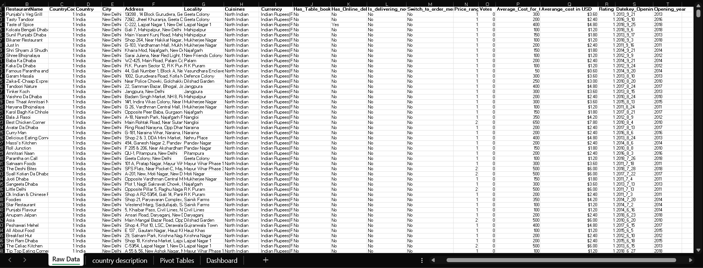
The image below shows the raw data after cleaning it:

Slide 9
PHASE 3
After cleaning our dataset we have our desired data on which we will perform our analysis using excel functionalities and formulas, after that we’ll put forward different insights that we acquired through the analysis, which can help our stakeholders.

Slide 10
Data Analysis
In this analysis I used arithmetic and aggregation functions like Sum(), Count(), Counta().
I used count() to find the total number of restaurants in the data base. The formula was =COUNT('Raw Data'!$A$1:$A$9552)
I also used count() with unique() and filter() to count the number of unique cities, countries and cuisines.
Formula for total number of unique cuisines is =COUNTA(UNIQUE(FILTER('Raw Data'!H2:H9552,'Raw Data'!H2:H9552<>"")))
Formula for total number of unique cities is =COUNTA(UNIQUE('Raw Data'!E2:E9552))
I used Sum() function to find total number of voters in the raw dataset. The formula was =SUM('Raw Data'!$O$1:$O$9552)

Slide 11
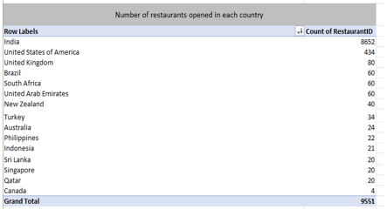
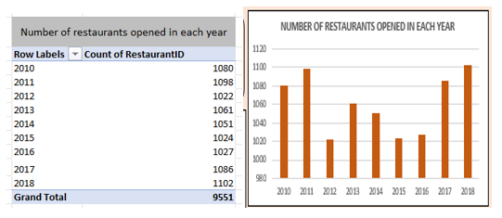
Insights
1. Analyzing restaurant trends
Explore the dining landscape globally. A pivot table will illustrate the number of restaurants in each country represented in our dataset, unveiling culinary hotspots around the world.
Total number of restaurants are 9551 from which 8652 (90.5 %) are located in India, following which USA has 434 and UK has 80 restaurants respectively. Canada has least number of restaurants i.e. 4.
Most number of restaurants opened in 2018 (1102), following that in 2011 (1098) and 2017 (1086).

Slide 12
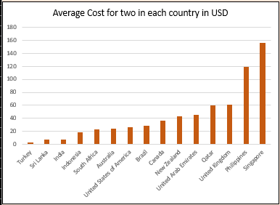
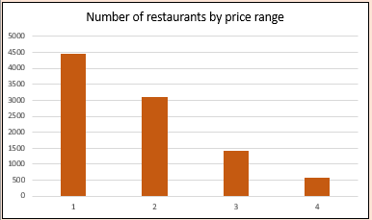
2. Exploring Price Dynamics
Unraveling the Influence of Geography on Dining Costs:
Singapore has highest average cost for two as 155.75 USD and Turkey is least expensive with avg. cost for two as 2.80 USD.
Understanding Price Ranges: From Budget-Friendly to Fine Dining Experiences:
Price range 1 has most number of restaurants as 4444 and price range 2 , 3, 4 has 3113, 1408 and 586 number of restaurants respectively.

Slide 13
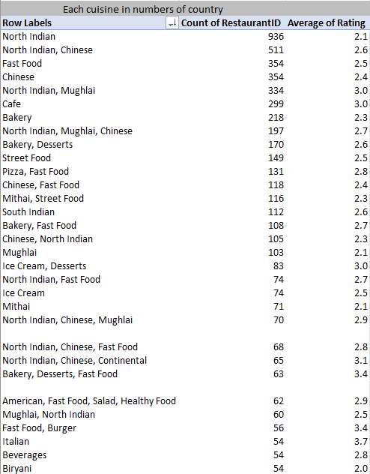
3. Unveiling Culinary Trends
A Culinary Melting Pot: Exploring the Diversity of Cuisines:
A visual representation will showcase the distribution of different cuisines, revealing the rich tapestry of flavors.
As we can see North India cuisine is the most popular cuisine and is available in 936 restaurants.
In the given data most popular cuisines are mostly from Indian restaurants because most number of restaurants are located in India.
Alongside number of restaurant the cuisine is available in we also have average rating of each cuisine which can also help us to identify most popular cuisine.

Slide 14
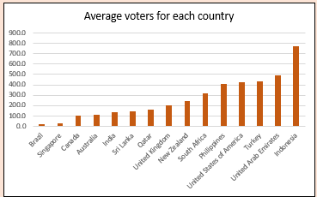
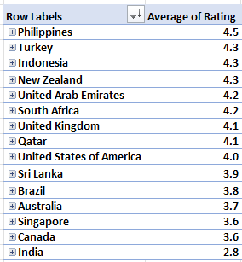
4. Gauging Customer Sentiment
Global Participation: Average Number of Voters Across Countries:
We have total of 1498645 voters
Indonesia has most average number of voters i.e. 772.1
Brazil has least average number of voters i.e. 19.6
Global Flavor: Average Ratings Across Countries:
Philippines has highest average rating of 4.5
India lowest average rating of 2.8, but we have to also remember that India has most number of restaurants.

Slide 15
PHASE 4
So now we are done with our analysis, it’s time for using the findings and insights we gathered to make recommendations, and at last we’ll present our dashboard by which our stakeholders can interact with and gain more insights needed.

Slide 16

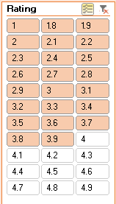
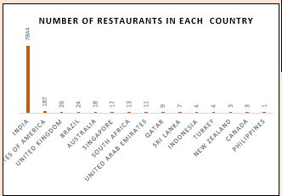




Recommendations
1. Recommended Countries
Some countries where the team can open the restaurants with lesser competition are:
Indonesia
Turkey
New Zealand
Canada
Philippines
Recommended countries are the countries with least number of restaurants among the low rated countries (less than 4).

Slide 17
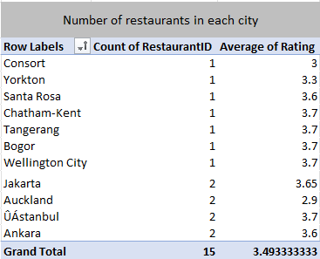
2. Recommended Cities
Some cities in the selected countries where the team can open the restaurants with lesser competition are:
CANADA: Consort, Yorton, Chatham-Kent
INDONESIA: Bogor, Jakarta, Tangerang
NEW ZELAND: Auckland, Wellington City
TURKEY: Ankara, Istanbul
PHILIPPINES: Santa Rosa

Slide 18
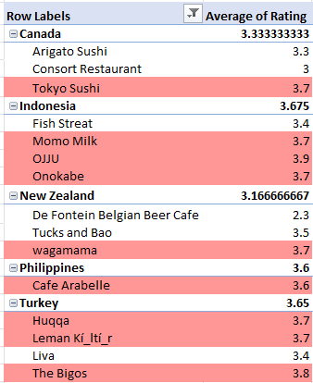
3. Biggest Competitors
restaurants from the recommended states that are our biggest competitors:
CANADA: Tokyo Sushi
INDONESIA: Momo Milk, OJJU, Onokabe
NEW ZELAND: Wagamama
TURKEY: Huqqa, Leman Kí_ltí_r , The Bigos PHILIPPINES: Café Arabelle
For our primary competitors, here is a pivot table I created for each restaurant by name in every location and nation. Restaurants with an average rating of more than 3.5 are regarded to be our primary competitors.

Slide 19
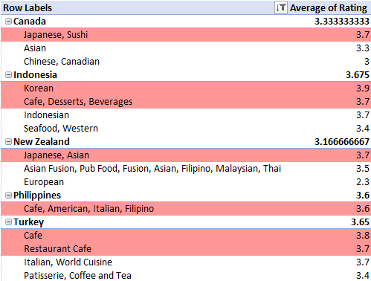
4. Recommended Cuisines
Cuisines for the restaurants according to the recommended countries:
CANADA: Japanese, Sushi
INDONESIA: Korean
Café, Desserts, Beverages
TURKEY: Café
Restaurant Café
PHILIPPINES: Café, American, Italian, Filipino
NEW ZELAND: Japanese, Asian
For cuisines I prepared a pivot table and pivot chart and selected the cuisines that have rating of more than 3.5 as recommended cuisines for every selected countries.

Slide 20
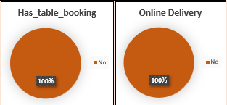
5. Recommended Services
Recommended services to be provided in our restaurants:
Online Delivery
Table Booking
As we can see, none of the restaurants in the selected cities offer online delivery or table booking, so we should definitely choose them; it will provide our customers with more options for how they want to eat their meal, put us one step ahead of our competitors, and help us expand our customer base and business.

Slide 21
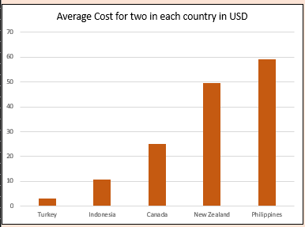
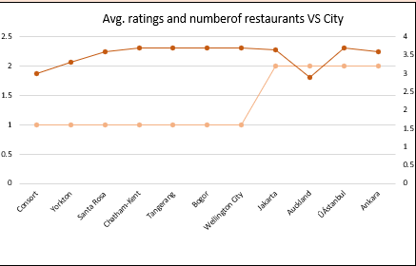
6. Recommended Cuisine Prices
We may adjust the prices when we calculate cuisine rates for our restaurant, because it has low-rated rivals.
As we can see, New Zealand and the Philippines have higher average costs, which we can compete with them by offering our meals at comparably cheaper pricing.
While we can raise our prices in Turkey and Indonesia to compete with restaurants there by providing our consumers with a sense of superior quality.

Slide 22
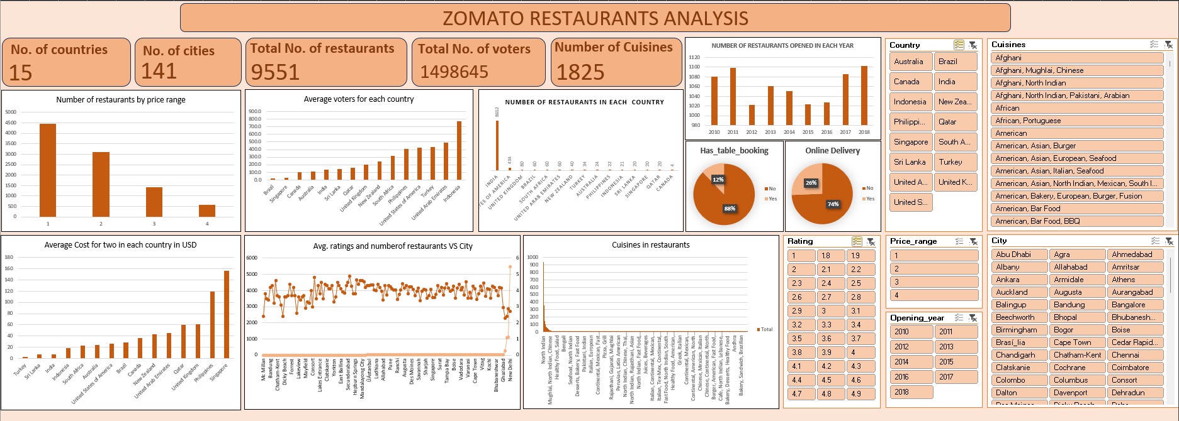
Dashboard Snippet

Slide 23
Conclusion
The analysis on dataset shows countries having the greater number of restaurants, and the services provided by restaurants in different countries and cities like online delivery and table booking.
We identified the most popular cuisines in the area based on the number of restaurants and user ratings.
We examined the correlation between restaurant pricing and customer ratings and found out that the correlation in 0.31 which means restaurant pricing and customer ratings are loosely correlated.
To sum up, Zomato restaurant data research may provide a thorough grasp of the regional eating scene, empowering businesses and other stakeholders to improve consumer experiences, make wise decisions, and take advantage of new trends.

Slide 24
Thank You

